Slide 1
AGING: KEY POINTS
Post OLLI
John G Thomas, PhD, Professor Emeritus
May 14, 2019
“Aging as a Disease: Are you crazy?”

Slide 2
ASSIGNMENT: www.globalbugs.com
Home Page. “What’s New”. Microbiology Re-Imagined, 1-5
Aging and Hologengenomic Center. A, Background, B, Development, 1-6.
Optional. Teaching with Puppets. “Culture Plate Gang” Marco Polo and Dexter.

Slide 3
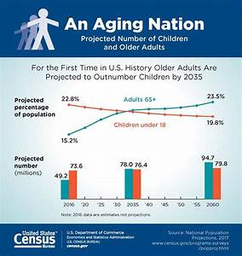

Slide 4
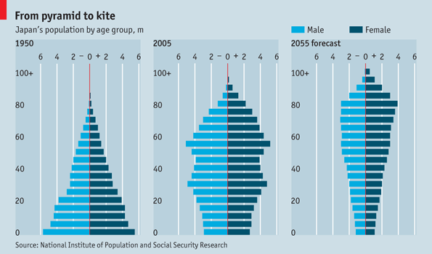

Slide 5
THE ROOT CAUSES OF AGING.
Damage and loss of Damage control
Accumulating Cross links
Buildup of Amyloid between Cells
The Failing Adaptive Immune System
The Failing Innate Immune System Declining Lysosomal Function
Mitochondrial DNA Damage
Nuclear DNA Damage Buildup of Senescent Cells

Slide 6
FOR. Front. Genet., 18 June , 2015
“Its time to Classify biological aging as a disease”
Background, history of Disease. “Normal vs abnormal defined by history, influenced by social and culture”. “New science revises whether a disease or not”. WHO Definition: “Disease is any abnormality of body structure or function”, influenced by social and biological aspects. Traditionally viewed as a natural process and consequently not a disease.
Aging as a Disease: WHO, Health. “a state of complete physical, mental and social well being and not merely the absence of disease of infirmity”. “Evolutionary theory teaches us the aging is caused by the decrease in force of selection against alleles with deleterious effects later in life”

Slide 7
It is time to classify biological aging a disease
Aging is a “harmful abnormality of bodily structure and function”. And aging has specific causes , each of which can be reduced to a cellular and molecular level, and recognizable signs and symptoms”.
Benefits of labeling Aging a Disease. Eliminates the ‘fatalism’ label of “natural” and legitimizes medical efforts to get rid of those undesirable conditions associated with it”.
$$$$$$$. Stimulate Grant – award bodies to support aging funding and encourage pharmaceutical support to develop biomedical procedures to slow the aging process. GEROPROTECTIVE DRUGS,REGENERATIVE MEDICINE, PRECISSION MEDICINE. Force FDA regulations to move from cosmetics to regulations for disease treatment. Have treatment refunded by Health Insurance Providers.

Slide 8
AGAINST. The Scientist Magazine, 23 Dec., 2016
“Aging, not a Disease”
OPINION. Refuted the arguments, describing aging as inevitable. Aging can not be avoided, and considers the arguments ilogic for aging as a disease. “The point is that aging as a descriptive term for the changes our bodies undergo over time cannot tell us a priori whether these changes are pathologic”

Slide 9
AGAINST. National Institute of Aging
Biodemographic Point of View
Refers to ICD Codes. Aging. International Statistical Classification of Diseases and Health Related Problems. ICD 10.
“Adult failure to thrive”
“The syndrome of psychophysical fading”
“Apathy of elder age”
Aging is the cause of many age-related diseases too broad to reduce to a single term.

Slide 10
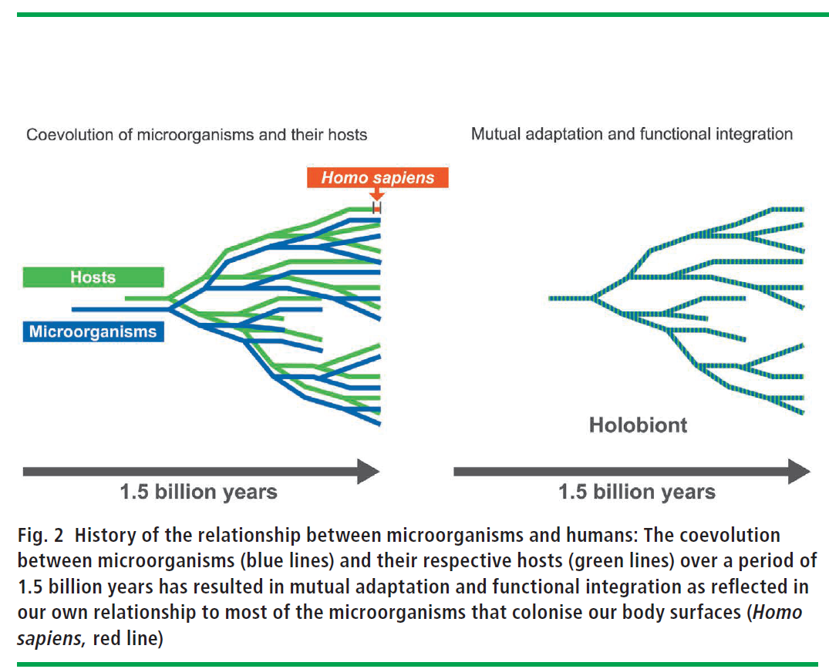

Slide 11
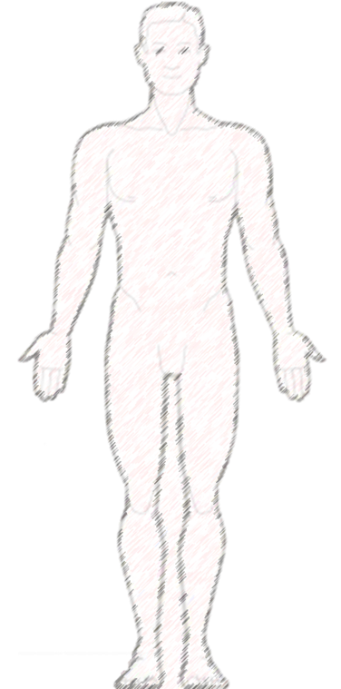

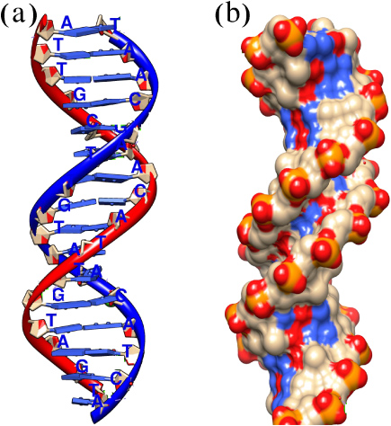

Self-Concept:
Alter Who We Are
Human
Microbiota
Microbes Matter
A / B / O
Blood Group
Phyla / Family
Enterotype
I, II, III
10 TRILLION
CELLS
100 TRILLION
CELLS
Siddhartha Mukherjee
The Emperor of all Maladies: A Biography of Cancer
Pulitzer Prize

Slide 12
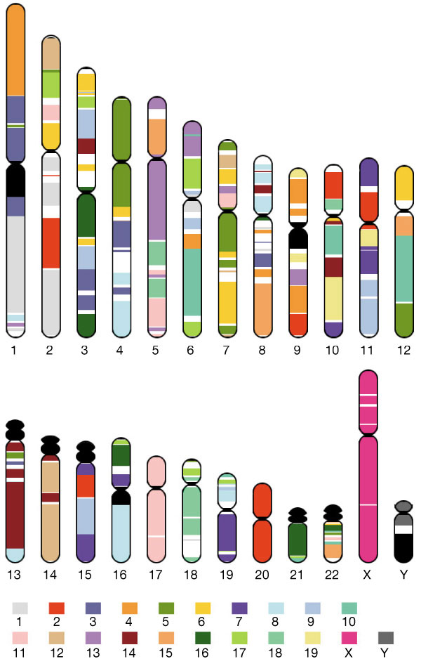
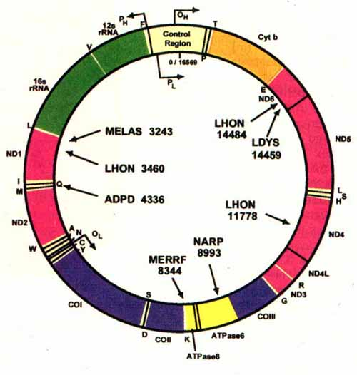
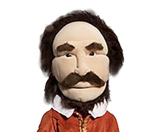


The Human vs. Bacterial Genomic Libraries
Human
Microbes
10^12 Eukaryotic Cells
10^14 Prokaryotic Cells
Cohabitation
INTELLEGENT
SYMBIOSIS
FACTS
23,000 Genes
8,000,000 Genes
25 year generation time
20 minutes generation time
Notes:
12

Slide 13
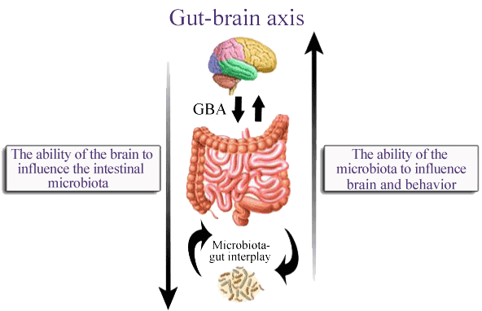



Slide 14
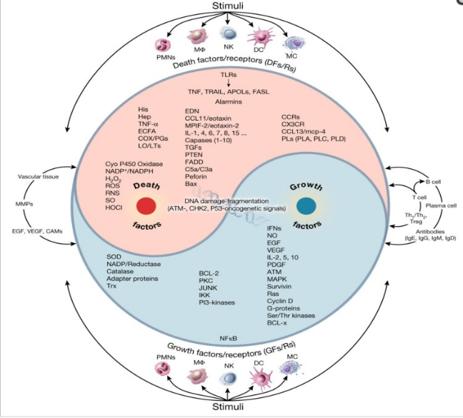
The GUT Brain link in AD (RED) and ADS (GREEN):
The Microbial Clock
Is bi-directional neurohumoral communication system
Neurodevelopmental deficits are frequently associated
with GUT symptoms and GUT dysbiosis
Modulation of the GUT microbiota is a promising
strategy (Probiotics)
Bacterial products amplify activity thru cytokine
release from mucosal immune cells , through
release of GUT hormones
Ying/Yang Hypothesis central theme, early and late

Slide 15
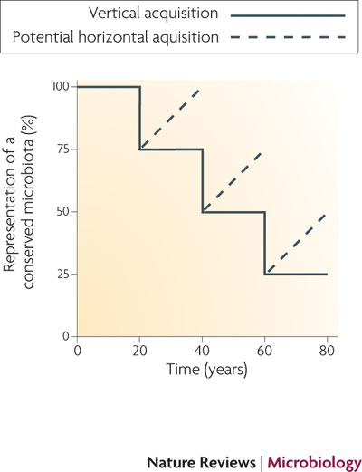
Human Microbiome
The Disappearing Microbiome
  Increase in allergic disease and asthma is a consequence of the disappearing microbiota- loss of our ancestral microorganisms
    Cleaner water, smaller families, reduced breastfeeding, widespread antibiotic use
  Is our cleanliness making us sick?
  COLLATERAL DAMAGE?
Blaser et al. Nat. Rev. Microbiol. 2009

Slide 16
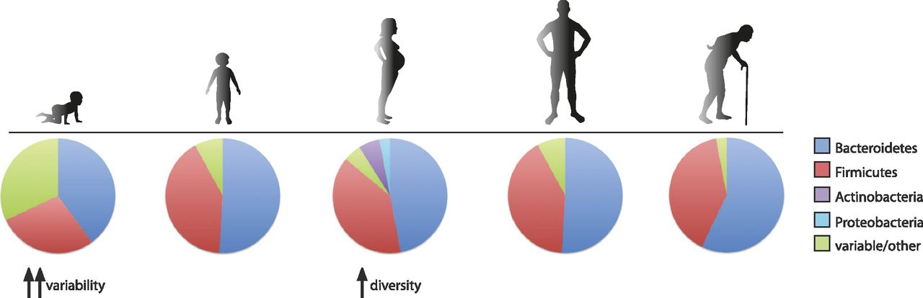

The structure of the human intestinal microbiota across the life cycle.
4 AGE GROUPS
A VISUALIZATION
Aleksandar D. Kostic et al. Genes Dev. 2013;27:701-718
Copyright © 2013 by Cold Spring Harbor Laboratory Press
Notes:
The structure of the human intestinal microbiota across the life cycle. The composition of the gut microbiome changes throughout the course of life. The infant microbiome shows great interindividual variability and relatively low diversity but becomes more diverse and converges into an “adult-like” structure by 3 yr after birth. Pregnancy is associated with an increase in Actinobacteria and Proteobacteria and increased diversity, but the gut microbiota returns to its original structure sometime after delivery. Old age (>65 yr) is associated with a number of changes in the microbiota, including an increase in the abundance of Bacteroidetes.

Slide 17


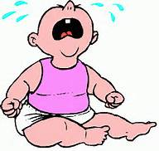


ENDOGENOUS Diseases: Microbial Clock
Mother/Newborn
Autism/Asthma
Aged Care
Nursing Homes
55.5 – 75 years old
0 – 12 years old
Daycare Center
Dementia
AGE
Cognitive Skills
Co-adaptation
Microbiota/Mycobiota and
Human Cells
Cancer/Tumors
18.5 – 55 years old
Skin
Gut
Vaginal
Osteoper
12,5 – 18 Years old
Connecting multiple diseases through A single framework or underlying cause
Martin J. Blaser, M.D.
Ref.
Adult
Adolescent
Diabetes
Obesity
Average age of U.S Population 37.5

Slide 18
BIOLOBIC CLOCK
2017 Nobel Prize in Medicine
3 American scientists, using fruit flies, reported in 1984, a period gene.
Further experiments explained how “plants, animals and humans adapt their biologic rhythms so that it is synchronized with Earths revolution”. Day vs Night.
Determined this was attributable to a PERIOD gene encoded protein (PER) that accumulated in cells at night, then degraded during day.
All multicellular organisms, including humans, operate a 24 hr clock which regulates functions including in humans: behavior, hormone levels , sleep, temp metabolism, blood pressure, heart rate and reaction time.

Slide 19
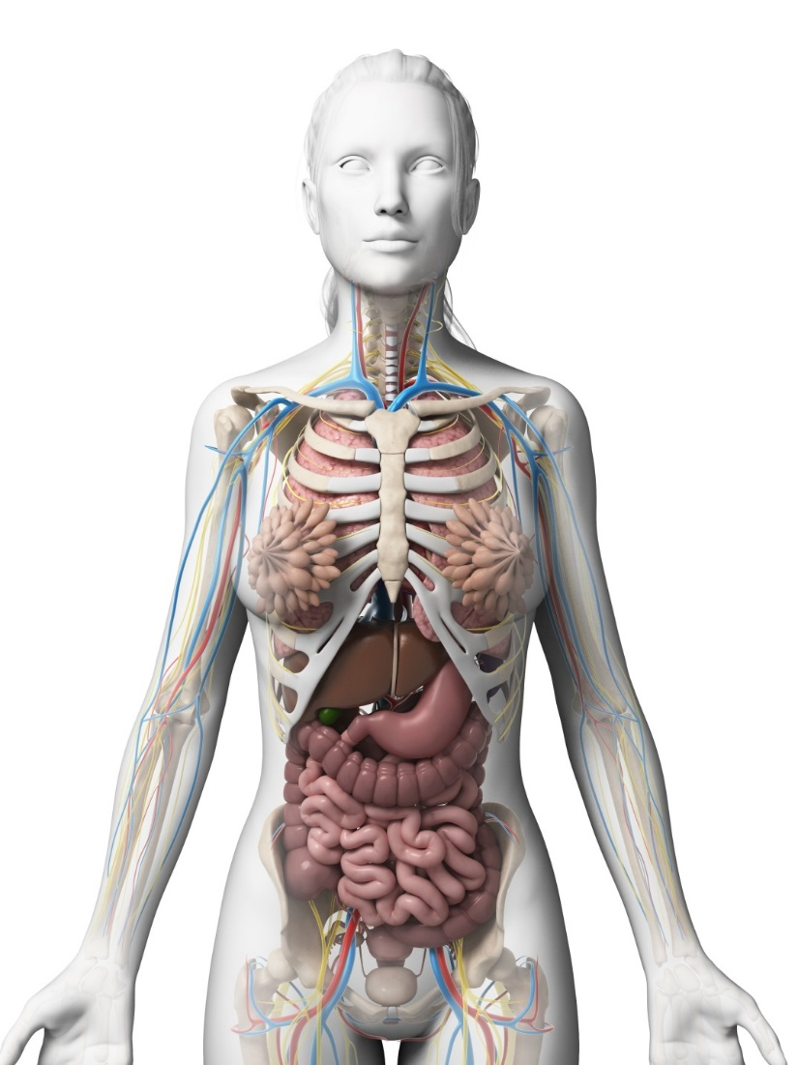
CIRCADIAN RHYTHMS: HUMAN CLOCKS
POSTER 1. Using a Multi-Tiered educational Data Base for Educational Decision Support
POSTER2 Aging, Our Microbial Clock and Probiotic intervention to Re-establish our Hologenomic Co Evolution Lineage
POSTER3 Aging, Diseases and Our Microbial Clock; Partners-4-Life
POSTER 4 Microbial Clock, Aging and Probiotics: Aging and Restorative Microbiology (Beneficial Microbes)
MICROBIAL AND BIOLOGIC
SHOW AND TELL

Slide 20
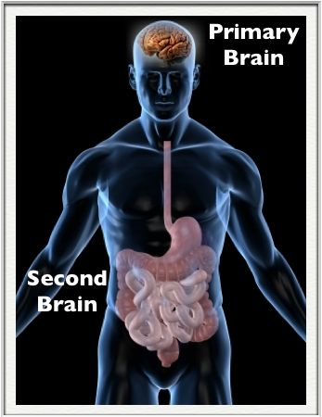
2015. Bulterijs,S. et al. “It is time to classify biologic aging as a Disease”
2016. Zhavoronkov and Moskalev. Editorial. “Should we Treat Aging as a disease? Academic, pharmaceutical and healthcare Policy and Pension Fund Perspectives.
2017
NIH. DEFINITION
Ghent, Belgium, EU
Brussels, Oxford UK
Editor, Alex Zhavoronkov,
“ Time to classify Aging as
A Disease, a consequence of
evolutionary NEGLECT, not
evolutionary INTENT. “
WWW.ncbi.NIH.GOV
2016. Lustgarten, M. Classifying Aging as a Disease: The Role of Microbes
4-5 lbs of Microbes

Slide 22
The GUT Brain link in AD (RED) and ADS (GREEN):
The Microbial Clock
Is bi-directional neurohumoral communication system
Neurodevelopmental deficits are frequently associated
with GUT symptoms and GUT dysbiosis
Modulation of the GUT microbiota is a promising
strategy (Probiotics)
Bacterial products amplify activity thru cytokine
release from mucosal immune cells , through
release of GUT hormones
Ying/Yang Hypothesis central theme, early and late

Slide 23


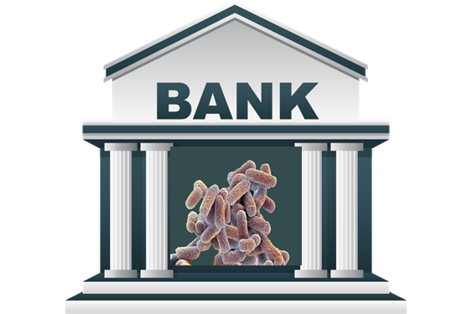
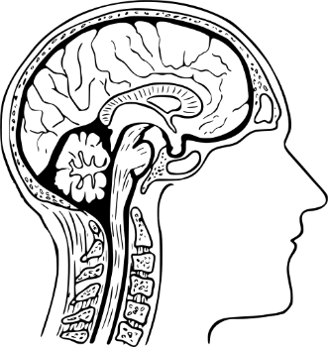
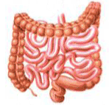
Wealth
Financial Health
Microbial Health
Information Managers
Money Manager
Gut Manager
FINANCIAL PORTFOLIO
DIVERSITY
MICROBIAL PORTFOLIO
Taxes
Time
Brain Drain
CLOCKS
Gains / Losses
Investment Rx
Nutrition Rx
RETIREMENT
Age Associated Diseases

Slide 24
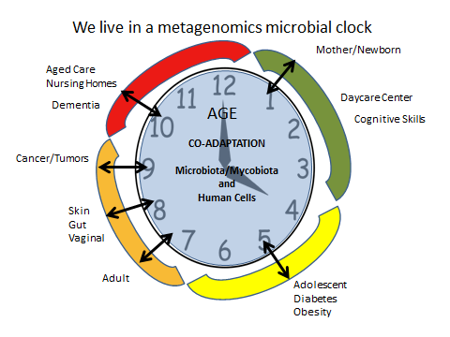
Microbial Clock: Future
Asthma / Autism
CRC
?
Osteo
142 / 100
Is Aging a Disease?
115 / 129

Slide 25
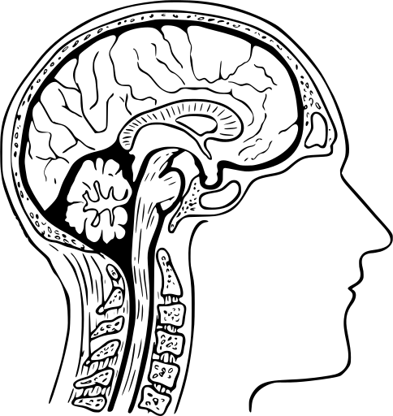
Hologenomic Theory: Utilizing Two Brains

